Slide 1
Health.Mo.Gov

Slide 2
6+++++
MO Adult Protective Services
Tim Jackson
Section Administrator- Section for Adult Protective Services

Slide 3
Today’s Objectives
Gain new/updated knowledge of:
Adult Protective Services (APS)
Who are Mandated Reporters of Adult Abuse
Signs & Symptoms of Adult Abuse, Neglect, and Exploitation
Expected Responses from APS staff

Slide 4
Division of Senior & Disability Services
Missouri’s Adult Protective Services (APS) promotes: safety, independence, and quality-of-life for vulnerable adults who are being abused, or are in danger of being abused, neglected by self or others, or financially exploited, and who are unable to protect themselves.
Mandated to investigate
Provide protective & support services
Empower seniors & adults with disabilities
Assist clients live safely in the least restrictive environment
Notes:
Missouri Adult Protective Services exists to promote safety, independence, and quality-of-life for vulnerable adults who are being abused, or are in danger of being abused, neglected by self or others, or financially exploited, and who are unable to protect themselves.
We are statutorily mandated to investigate reports of abuse, neglect, and exploitation. And if that abuse, neglect, or exploitation rises to the level of a crime, we pursue justice through the criminal justice system with the support of law enforcement and local prosecutors.
We provide support services to help victims get past an abusive, neglectful, or exploitative situation.
We empower clients and help them to ensure they can live safely in the least restrictive environment for them.

Slide 5
Who Does APS Serve?
Missourians who are….
60 years and older
OR
18-59 years with a mental
or physical disability
…and unable to protect his or her own interests or adequately perform or obtain services which are necessary to meet his or her essential human needs.
Notes:
[start at the top of the slide]
I’d like to note that the part after the second ellipse is very difficult to establish because it’s so subjective. As a result, we reject very few reports based on that part of the statutory language.

Slide 6
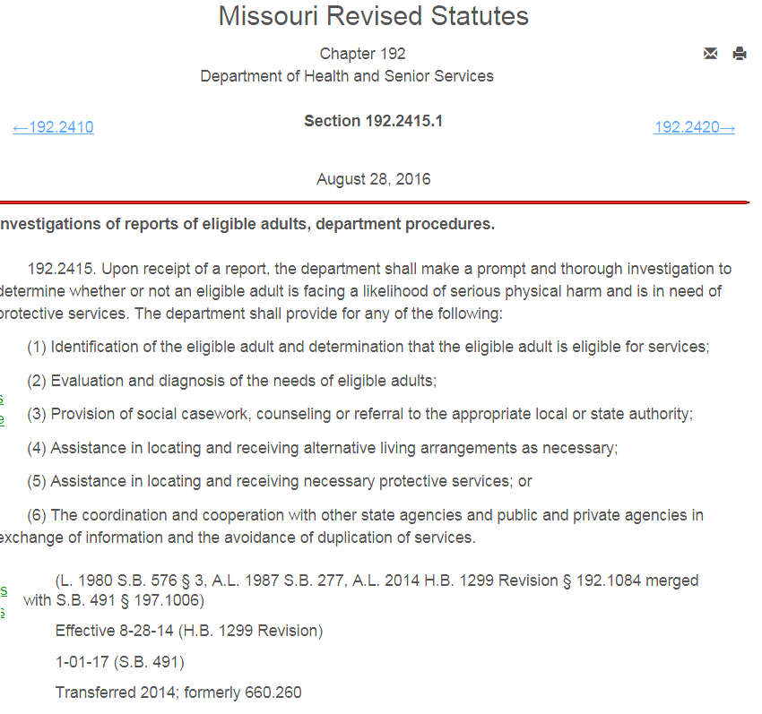
DHSS shall investigate…
192.2415, RSMo.:
“Prompt & thorough” investigation to determine…
Likelihood of serious physical harm AND
Protective Service needs
Determine Needs
Social Casework, Counseling or Referral
Assist with locating Alternative Living
Provide Protective Services
Coordinate with other agencies in exchange of info and avoidance of service duplication
Notes:
Upon receipt of a report…
…The Department is responsible for making a prompt and thorough investigation to determine whether or not an eligible adult is facing a likelihood of serious physical harm and is in need of protective services.
If it’s determined that the client is at risk for future harm or has endured harm and needs protective services, APS is required to do the following…
1> Evaluate the client’s needs
2> Provide casework, counseling or referral to appropriate agencies to provide assistance to the individual. So, we’re linking the person with whatever support services they need to stabilize their situation and ensure a safe plan moving forward.
3> Assistance in locating alternate living arrangements if needed to maintain safety.
4> Assistance with protective services such as in-home assistance (through Medicaid), assistance with legal actions, or pursuit of justice through the criminal justice system.
5> Coordinating with other agencies to exchange info regarding client needs and avoid duplication of services

Slide 7
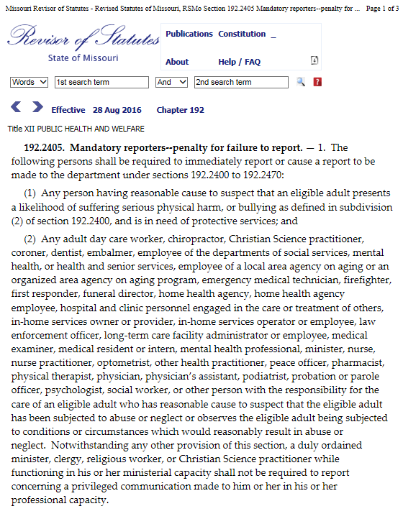
Are you a mandated reporter?
192.2405 RSMo.
EMT, Firefighters, First Responders
Law Enforcement
Probation & Parole Officer
Social Worker
Notes:
So, here is the list of mandated reporters. If you’d like to view this or the previously referenced statutes…
Go to health.mo.gov/abuse and on that page, there is a link
Or search on Google for RSMo 192.2405 (for mandated reporters).
So now let’s talk about some of the signs and symptoms of Abuse, Neglect, Self-Neglect, and Exploitation

Slide 8
What is Abuse?
“Abuse is a form of mistreatment by one individual that causes harm to another person”
National Adult Protective Services Association
MO Statute 192.2400(1) "Abuse", the infliction of physical, sexual, or emotional injury or harm including financial exploitation by any person, firm, or corporation and bullying.
Notes:
Let’s define abuse.

Slide 9
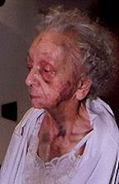
Signs & Symptoms of Abuse
Bruises/Abrasions/Welts
Unknown cause or story does not match injury
Burns
Skin Tears
Actions Likely to Caused Injury
Internal injuries
Shaken
Restraints
Linear marks on wrists/ankles
Notes:
On the screen, we have listed a few physical indicators of abuse…
Remember that Injuries such as bruises or lacerations are often hidden by clothing. This may be even more true with seniors as we often stereotype them as always being cold and therefore we don’t pay much attention.
Bruises found on the extremities are often accidental while bruises on the neck, bottom of the feet, or genitals are commonly signs of abuse. Or, bruises in the shape of an object can indicate abuse. Bruising on a non-ambulatory person is also questionable.
Other NON-physical indicators include: sudden changes in behavior, stories inconsistent with injuries…also look at the caregiver’s behavior – are they isolating the victim by intercepting mail or restricting phone calls & visits, asking more financial questions than care questions, or holding unrealistic expectations of the victim’s abilities.
Note on Sexual Abuse:
Just as with Child Abuse, we consider sexual abuse to be contact with any person incapable of giving consent or any sexual behavior that a reasonable person would find unwanted and/ or offensive.

Slide 10
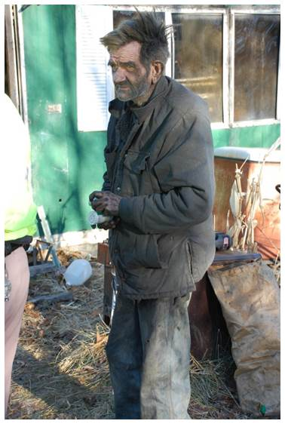
Signs & Symptoms of Caregiver Neglect
Refusal or failure to fulfill a legal or contractual responsibility…includes:
Failing to provide life necessities, e.g., food, water, clothing, shelter, etc.,
Failing to provide for or pay for care
Delaying seeking medical care
Notes:
On the screen here, we have some examples of Neglect or Caregiver neglect.
Typically neglect includes refusal or failure to provide for life necessities such as food, water, clothing, shelter, personal hygiene, medicine, or personal safety when there is a responsibility to care for the elder or adult w/ a disability. Neglect may also include failure of a person who has fiduciary responsibilities to provide or pay for care.
One thing to point out is that the caregiver has to have legal or contractual responsibility to provide care.

Slide 11
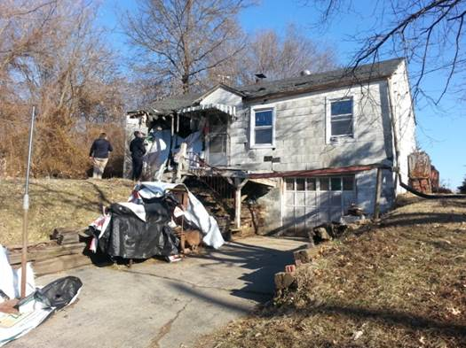
Signs & Symptoms of Self-Neglect
Poor hygiene
Unhealthy and hazardous living environment
Untreated health problems
Loss of weight
Frequent incidents of falls
Excludes mentally competent person
making bad decisions
Notes:
On the screen, we have some indicators of self-neglect. Remember, neglect is the failure to provide life necessities such as food, water, clothing, shelter, personal hygiene, medicine, or personal safety. So, when we’re looking at self-neglect, it’s about what kind of danger the vulnerable adult is placing themselves in. To that point, self-neglect excludes situations in which a mentally competent person, who understands the consequences of his/her decisions, makes a conscious and voluntary decision to engage in acts that threaten his/her health safety as a matter of personal choice.
We must consider that the law protects the Right of Self Determination for all competent adults. So, it is important when investigating reports of self neglect to determine the person’s mental capacity. If the self-neglect is a result of a bad decision made by a competent person, we may only be able to provide them with information on available resources. However, if the self-neglect is a result of confusion, their may be a protective service need.
The determining factor is that the individual knows and understand the consequences of their decisions/actions.
Example… a person lives in an upstairs apartment, unable to negotiate a path to safety- i.e. bed bound, competent and alert... knows that in case of fire, they will not be able to get out - however choose to remain in their home. This would not be considered self neglect.
You may ask yourself: Why do seniors self neglect?
They don’t know the extent of services available
Don’t seek assistance because they are afraid of losing their autonomy.
Afraid to ask for help as that might draw attention to the fact that they are having trouble
Some seniors’ mental abilities begin to deteriorate which prevents them from even recognizing the fact they cannot care for themselves.
Not easy to admit that we can no longer care for ourselves
Most times, self neglect goes unnoticed until health or building codes are violated. By this time, the self neglect has gotten to the point of significant deterioration in the person’s health.

Slide 12
Signs & Symptoms of Financial Exploitation
Large withdrawals from bank accounts, switching accounts, unusual ATM activities
Signatures don’t match
Multiple disbursement for similar items over short period of time
Unusual expenses paid/unable to explain
Drastic changes in distribution of wealth at time of death (POA, Trust, Wills)
Unpaid bills
Mismatch between life circumstances and the size of estate
Notes:
Next up, Financial Exploitation:
Most people think of telemarketing, contractor fraud, or investment scams when they hear the words “Financial Exploitation” HOWEVER…We find that exploitation is often committed by a person who is in a position of trust. So here are a few things to look for….
Sudden change in banking practices…numerous checks written to cash, ATM usage by a homebound person, more frequent cash withdrawals beyond the person’s normal routine.
Unable to explain finances/expenditures…no memory of signing documents…make loans to others w/no arrangements for repayment
Caregiver’s behavior…asking more financial questions than care questions or making large purchases that don’t benefit the senior or adult with a disability EX: Son using mom’s money to purchase himself a new truck, saying this is needed to transport mom to her Dr. appointments.
Misuse of a Power of Attorney (POA)…a POA can be a convenient legal means to plan for the future but can be misused as there is little accountability or oversight. MO law sets forth fiduciary responsibilities of the POA (404.714-717, RSMo) and says the agent must act in the best interests of the principal.
It’s important to note that Exploitation is not just the amount of money that is taken, but the impact it has on the victim.

Slide 13
Notes:
Here’s a breakdown of the types and percentage of allegations we receive:
As you can see, the vast majority of reports we receive are related to Self-Neglect… followed by Financial Exploitation.
We receive a total of about 30,000 reports each year.
Average victim : Female, average age is approximately 66, white, lives alone
Average Alleged Perpetrator: Female, average age is approximately 51, white, typical relationship of adult child.

Slide 14
APS Response After Report
Investigation initiated within 24-48 hours depending upon the classification
Immediate response to reporter and/or victim
Interviewing and collecting evidence (medical/financial records; statements; photos)
Accessing other resources for victim
Determining Need for Protective Service
Monitoring/Evaluate impact of services or resources arranged (may need on-going Protective Services)
Notes:
Initiated within 24-48 hours from receipt of the hotline call at CRU. Normally, this includes a call to the Reporter to gather any additional information.
Classifications and response time frames of reports depend on the degree of imminent harm or potential for harm to the Client.
Depending on the situation , we will try to make contact with the reporter, see the victim, interview AP (if any) and interview witness. At this point we would provide intervention/ support/ and make the victim aware of available options.
The investigation may include contacting other resources such as law enforcement, DMH, Public Administrators, doctors, banks, utility companies, etc. to gather information or to request assistance.
Our Workers have 60 days to conclude an investigation.

Slide 15
Individual’s Rights
Confidentiality
Information will be kept confidential.
Missouri statutes prohibit release of information
Choose to receive or refuse services and support
Feel Secure
Protective
Services
Client's
Rights
Notes:
Clients have rights in regards to Adult Protective Services.
First off, all reports are confidential and only accessible by the Adult Victim or an authorized representative. Reporter information is strictly confidential and redacted if the case is ever released.
And then…
Obtaining a balance between providing protective services and respecting a client’s rights is a difficult but very important part of what we do. A competent client always has the right to refuse services or assistance.

Slide 16
Our Services
Insert your awesome subtitle here
We Can:
We Cannot:
Provide protective services interventions
Authorize in-home services when criteria met
Intervene when an adult is incapacitated and needs medical or mental health intervention
Intervene on behalf of incapacitated adult to identify a representative or explore legal interventions
Transport under any circumstances
Remove or evict an adult from their home
Place an adult in a mental health facility, nursing home or hospital
Force a competent adult to change their behavior or lifestyle

Slide 17
Adult Abuse & Neglect Hotline
Hours of Operation – 7:00 AM to 8:00 PM 7 days a week including holidays
or
https://health.mo.gov/abuse
Notes:
We need your help!
Know the indicators of abuse, neglect and exploitation
Call or submit a report if you suspect it is happening to an elderly or disabled adult.
We ask that Mandated Reporters use our Online Reporting method to free up phone lines.

Slide 18
QUESTIONS?
Tim.Jackson@health.mo.gov
573-472-6696
Health.Mo.Gov

Slide 19
PROTECTING HEALTH AND
KEEPING PEOPLE SAFE

